Slide 1
What is an embedded clause?
Notes:
Adapted from primary resources

Slide 2
An embedded clause
adds information to a
sentence.
It adds information by
‘sandwiching’ it into
the sentence.

Slide 3
We use a comma followed by the word who, which, that or with to introduce an embedded clause.
The ferocious dog barked noisily through the hole in the fence.
The ferocious dog, who was trying to scare away the burglars, barked noisily through the hole in the fence.

Slide 4
The ferocious dog, who lived next door, barked noisily through the hole in the fence.
The cloaked man, who has a voice as deep as thunder, sat in the corner of the dank room.
The barren landscape, with only a few sheep visible on the horizon, was a lonely place to be.

Slide 5
Can you add an embedded clause into this sentence?
King Hrothgar built a magnificent mead-hall called Heorot.

Slide 6
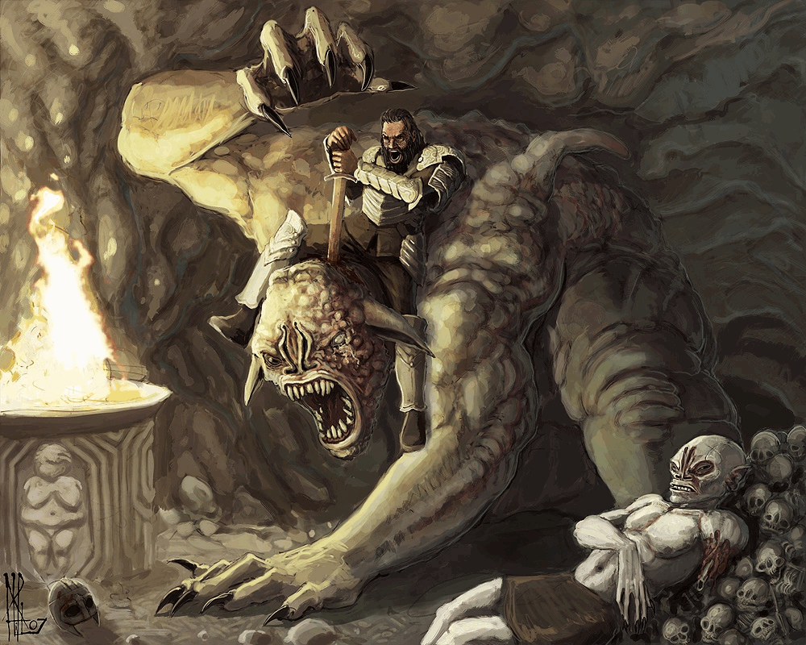
Can you add an embedded clause into this sentence?
Grendel roared as he ripped open the doors into Heorot.

Slide 7
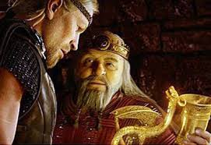
Can you write a clause that is not embedded?
Yes – A clause can also be at the start or the end of a sentence, it does not work as a sentence on it’s own but adds to the sentence (a subordinate clause)
Can you write a subordinate clause for this sentence?
Beowulf introduced himself to the great king Hrothgar.

